Slide 1
TWITTER LIKE SERVICE
GROUP 1
Patrick Burton
Arvind Nair
Lakshmi Swathi Chavvakul

Slide 2
Objective
Provide a tweeting interface for users to communicate on
Simple messages
An extendable reusable component

Slide 3
REQUIREMENTS
The user should be able to tweet from the web service
User should be able to Tweet from the mobile application
A tweet from one source (web or mobile) should show up in the other source.

Slide 4
MOTIVATION

Slide 5
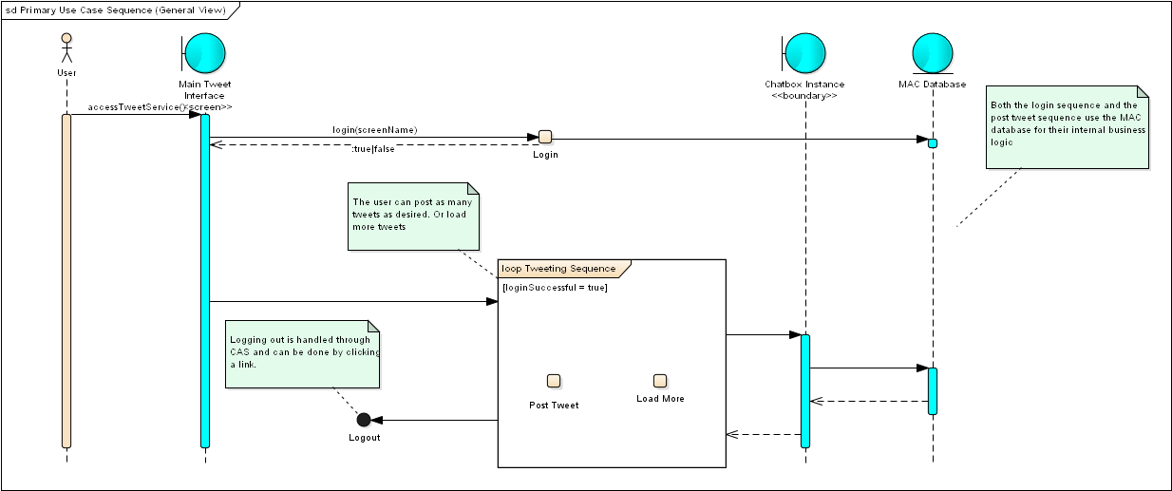
IMPLEMENTATION: (Tweet from web or mobile)
Notes:
* Main tweet interface can be accessed from online or a phone via the browser

Slide 6
Architecture - Design
Parallel Communicating Processes Architecture
For each user, separate session is created.
Client Server
Has user as client and server as AWS with presentation, business logic and database layer.
Repository
Adding data, retrieving data and storing data.

Slide 7
APPROACH AND METHODOLOGY
Systems chosen:
Apache, MySql, HTML5, Typescript, CSS3
Accessing the service
Screen name vs. actual name
Authentication
Posting tweets
ACID compliant

Slide 8


ARCHITECTURE – Front End
Front end:
Typescript
Dynamically generated content
Modular JavaScript
Maintainability
Scalability
HTML5
Built in needed functionality
E.g. Filesystem access
CSS3
Responsive and expressive
Mobile and Desktop views
Supported in major browsers

Slide 9




ARCHITECTURE – Back End
Portable to major systems:

Slide 10
No Native App Explanation
HTML5
All the native functionality of a built in app
E.g. Filesystem
Expressiveness of CSS3 and HTML
No need to install an app
Not constrained by size of of harddrive
Can take almost computation off the client and onto the server
Potential for distribution of work across devices

Slide 11
METRICS
Requirement Metrics
Unambiguity Metric
Testability Metric
Comprehensiveness Metric

Slide 12
Unambiguity Metric
Requirements should be clear. (0,1,2)

Slide 13
Testability Metric
Is requirement testable? (Yes or No)

Slide 14
Comprehensiveness Metric
Number of requirements included (Yes or No)

Slide 15
Metrics
Design Metrics
Understandability
Sufficiency
Security

Slide 16
Understandability Metric
How understandable are components and connections(0 to 10)

Slide 17
Sufficiency Metric
Satisfies basic requirements (0 to 10)

Slide 18
Security Metric
Shows expected vulnerabilities. (0 to 10)

Slide 19
Metrics
Implementation Metrics
Sufficiency
Security
Robustness

Slide 20
Sufficiency Metric
Percentage of requirements that are implemented.

Slide 21
Security Metric
How strong is security in the software (0, 1, 2)

Slide 22
Robustness Metric
Input fields response to anomalous inputs. (0, 0.5, 1)

Slide 23
Methodology – Black Box

Slide 24
CHALLENGES
Implementation
Metrics
Testing

Slide 25
FUTURE IMPLEMENTATION

Slide 26
References
Php logo: http://upload.wikimedia.org/wikipedia/fi/thumb/e/e0/MySQL-n_logo.svg/800px-MySQL-n_logo.svg.png
MySQL logo: http://upload.wikimedia.org/wikipedia/commons/2/27/PHP-logo.svg
HTML5/CSS3 Logo: http://geteverything.org/wp-content/uploads/2013/08/13.png
TypeScript Logo: http://blog.xebia.fr/wp-content/uploads/2014/03/typescript-logo.png
Apache logo: http://goodlogo.com/images/logos/apache_software_foundation_logo_3074.gif

